Slide 1
Highly confidential Security System

Slide 2
Objective :
The purpose of these guidelines is to assist some highly
confidential data means personal, Departments, Offices and
Agencies for this implementing systems that will ensure, as much
as possible, that personal data.
-obtain and process personal data fairly;
- Process it only in ways compatible with the purposes for which it was given initially
- keep personal data safe and secure;
- keep data accurate, complete and up-to-date;
- provide a copy of his/her personal data to any individual, on request.
This Project gives security on how personal data is to be stored, handled and

Slide 3
Protected under the following Personal Confidential data:-
All mailids, passwords
All bank account no
Insurance policy No
PAN NO
Driving License No
All education certificate Numbers
Some highly value scan copy
Some confidential photo and music, videos

Slide 4
Present Working System :
Due to busy life style we can’t remember all confidential data like All maid Id, Password, All bank account no, Insurance policy No, PAN NO, Driving License No, Password PortNo,All education certificate Numbers, Some highly value scan copy, some confidential photo and music ,videos.

Slide 5
To Be Praposed :
So we can develop highly security web application (Elliptic Curve Cryptography security algorithm). So we can store all confidential data in single credentials.
The development of this new system contains the following activities, which try to automate the entire process keeping in the view of database integration approach with highly confidential security.
This system maintains user data in encryption description format using algorithms.

Slide 6
This system maintains user’s personal, address, and contact details.
User friendliness is provided in the application with various controls provided by system rich user interface.
This system makes the overall project management much easier and flexible.
Various classes have been used for maintain the details of all the users and catalog.
Authentication is provided for this application only registered users can access.
Report generation features is provided using to generate different kind of reports.
The system provides facilities to maintain bank account information.
The system provides facilities to maintain Mails, password account information.
The system provides facilities to maintain all education information marks memo, scaned copies information.
The system provides facilities to maintain License, passport, insurances account information.
The system provides facilities to maintain personal Files Information videos, images account information.
System provides facility to online user registration.
This system is providing more memory for the users to maintain data.
This system is providing accessibility control to data with respect to users.

Slide 7
Modules of the System
Administrator Module
User Module
Encryption Description Module
Security Authentication
Reports

Slide 8
Functional Requirements of the Project:
Administrator:
View Users
Accept or reject user authentication
Delete user (or ) user Authentication
User:
Banks Accounts Information
Add Banks Accounts Information
View Banks Accounts Information
Update Bank Account Information
Delete Bank Acc Information

Slide 9
Mails Information
Add Mails
View Mails
Update Mails
Delete Mails
Career Information
Add Study Details
View Study Details
Delete Study Details
Update Study Details
License Details
Add License Details
View License Details
Delete License Details
Update License Details

Slide 10
Passport Details
Add Passport Details
View Passport Details
Delete Passport Details
Update Passport Details
Pan card Details
Add pan card Details
View pan card Details
Delete Pan card Details
Update Pan card Details
Add Insurance Details
Add Insurance Details
View Insurance Details
Delete Insurance Details
Update Insurance Details
Imp Files Details
Add
View
Delete
Update

Slide 11
Encryption and Decryption Module:
ECC is abbreviated as Elliptic Curve Cryptography:

Slide 12
Security and Authentication:
Login
Logout
Registration
Change Passwords
Forget Password
View Profile
Update Profile

Slide 13
Reports
Generating Different Format report To be download (.xls, pdf, html, txt)

Slide 14
SOFTWARE REQUIREMENTS
Operating System : Windows XP/2007 or Linux
User Interface : HTML, CSS
Client-side Scripting : JavaScript
Programming Language : Java
Framework : struts 1.x, Hibernate 3.0
IDE/Workbench : My Eclipse 8.6
Database : Oracle 10g xe
Server Deployment : Tomcat 6.0/7.0

Slide 15
HARDWARE REQUIREMENTS
Processor : Core 2 Duo
Hard Disk : 160GB
RAM : 1GB or more

Slide 16
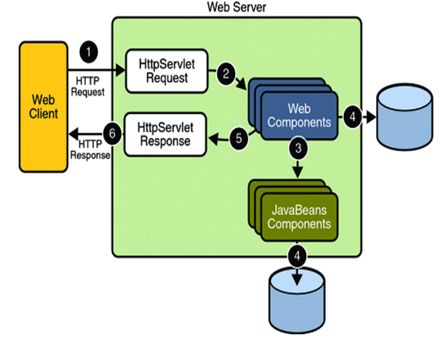
SYSTEM REQUIREMENT SPECIFICATION :

Slide 17
PROCESS FLOW:
THE PRESENTATION LAYER:
Also called as the client layer comprises of components that are dedicated to presenting the data to the user. For example: Windows/Web Forms and buttons, edit boxes, Text boxes, labels, grids.
THE BUSINESS RULES LAYER:
This layer encapsulates the Business rules or the business logic of the encapsulations. To have a separate layer for business logic is of a great advantage. This is because any changes in Business Rules can be easily handled in this layer. As long as the interface between the layers remains the same, any changes to the functionality/processing logic in this layer can be made without impacting the others. A lot of client-server apps failed to implement successfully as changing the business logic was a painful process

Slide 18
Process Flow:
THE DATA ACCESS LAYER:
This layer comprises of components that help in accessing the Database. If used in the right way, this layer provides a level of abstraction for the database structures. Simply put changes made to the database, tables, etc do not affect the rest of the application because of the Data Access layer. The different application layers send the data requests to this layer and receive the response from this layer.
THE DATABASE LAYER:
This layer comprises of the Database Components such as DB Files, Tables, Views, etc. The Actual database could be created using SQL Server, Oracle, Flat files, etc. In an n-tier application, the entire application can be implemented in such a way that it is independent of the actual Database. For instance, you could change the Database Location with minimal changes to Data Access Layer. The rest of the Application should remain unaffected

Slide 19
FUNCTIONAL REQUIREMENTS:
Administrator:
Register employees, departments
View Employees welfare
Employee:
View and update their profile details.
Share their welfare related information.
Delete their information according to requirements.
Security and Authentication:
Login as Admin and employee.
Logout
Registration
Change password

Slide 20
Non Functional Requirements:
Performance Requirements:
Some of the attributes of software that relate to the ease of porting the software to other host machines and/or operating systems.
This may include:
Java is used to develop the product. So it is easiest to port the software in any environment.

Slide 21
Maintainability:
The user will be able to reset all options and all stored user variables to default settings.
Reliability:
Some of the attributes identified for the reliability is listed below:
All data storage for user variables will be committed to the database at the time of entry.
Data corruption is prevented by applying the possible backup procedures and techniques.
Usability requirements:
Some of the usability requirements identified for this system are listed below:
A logical interface is essential to an easy to use system, speeding up common tasks.
Error prevention is integral to the system and is provided in a number of formats from sanity hacks to limiting free-text input.

Slide 22
Availability:
All cached data will be rebuilt during every startup. There is no recovery of user data if it is lost. Default values of system data will be assigned when necessary
Software System Attributes:
There are a number of attributes of software that can serve as requirements. It is important that required attributes by specified so that their achievement can be objectively verified. The following items provide a partial list of examples.
The input system will allow for inputting numbers, operands, special symbols and letters of the alphabet.

Slide 23
FEASIBILITY STUDY:
TECHNICAL FEASIBILITY:
Evaluating the technical feasibility is the trickiest part of a feasibility study. This is because, at this point in time, not too many detailed design of the system, making it difficult to access issues like performance, costs on (on account of the kind of technology to be deployed) etc. A number of issues have to be considered while doing a technical analysis.
Understand the different technologies involved in the proposed system:
Before commencing the project, we have to be very clear about what are the technologies that are to be required for the development of the new system.
Find out whether the organization currently possesses the required technologies:
Is the required technology available with the organization?
If so is the capacity sufficient?
For instance –
“Will the current printer be able to handle the new reports and forms required for the new system?”

Slide 24
Availability:
All cached data will be rebuilt during every startup. There is no recovery of user data if it is lost. Default values of system data will be assigned when necessary
Software System Attributes:
There are a number of attributes of software that can serve as requirements. It is important that required attributes by specified so that their achievement can be objectively verified. The following items provide a partial list of examples.
The input system will allow for inputting numbers, operands, special symbols and letters of the alphabet.

Slide 25
FEASIBILITY STUDY:
TECHNICAL FEASIBILITY:
Evaluating the technical feasibility is the trickiest part of a feasibility study. This is because, at this point in time, not too many detailed design of the system, making it difficult to access issues like performance, costs on (on account of the kind of technology to be deployed) etc. A number of issues have to be considered while doing a technical analysis.
Understand the different technologies involved in the proposed system:
Before commencing the project, we have to be very clear about what are the technologies that are to be required for the development of the new system.
Find out whether the organization currently possesses the required technologies:
Is the required technology available with the organization?
If so is the capacity sufficient?
For instance –
“Will the current printer be able to handle the new reports and forms required for the new system?”

Slide 26
OPERATIONAL FEASIBLITY:
Proposed projects are beneficial only if they can be turned into information systems that will meet the organizations operating requirements. Simply stated, this test of feasibility asks if the system will work when it is developed and installed. Are there major barriers to Implementation? Here are questions that will help test the operational feasibility of a project:
Is there sufficient support for the project from management from users? If the current system is well liked and used to the extent that persons will not be able to see reasons for change, there may be resistance.
Are the current business methods acceptable to the user? If they are not, Users may welcome a change that will bring about a more operational and useful systems.
Have the user been involved in the planning and development of the project?
Early involvement reduces the chances of resistance to the system and in
General and increases the likelihood of successful project.
Since the proposed system was to help reduce the hardships encountered. In the existing manual system, the new system was considered to be operational feasible.

Slide 27
ECONOMIC FEASIBILITY:
Economic feasibility attempts 2 weigh the costs of developing and implementing a new system, against the benefits that would accrue from having the new system in place. This feasibility study gives the top management the economic justification for the new system.
A simple economic analysis which gives the actual comparison of costs and benefits are much more meaningful in this case. In addition, this proves to be a useful point of reference to compare actual costs as the project progresses. There could be various types of intangible benefits on account of automation. These could include increased customer satisfaction, improvement in product quality better decision making timeliness of information, expediting activities, improved accuracy of operations, better documentation and record keeping, faster retrieval of information, better employee morale.

Slide 28
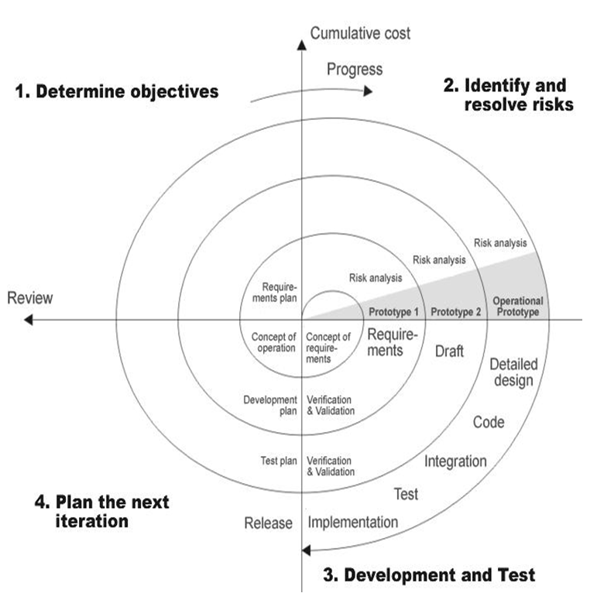
SPIRAL MODEL:

Slide 29
Applications:
Spiral Model is very widely used in the software industry as it is in synch with the natural development process of any product i.e. learning with maturity and also involves minimum risk for the customer as well as the development firms. Following are the typical uses of Spiral model:
When costs there is a budget constraint and risk evaluation is important.
For medium to high-risk projects.
Long-term project commitment because of potential changes to economic priorities as the requirements change with time.
Customer is not sure of their requirements which is usually the case.
Requirements are complex and need evaluation to get clarity.
New product line which should be released in phases to get enough customer feedback.
Significant changes are expected in the product during the development cycle.

Slide 30
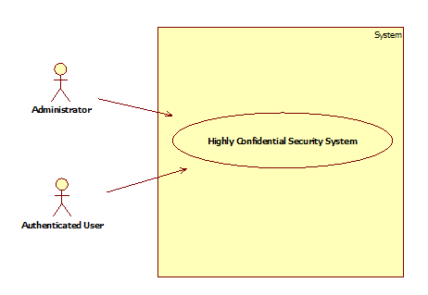
system Use Case Diagram

Slide 31
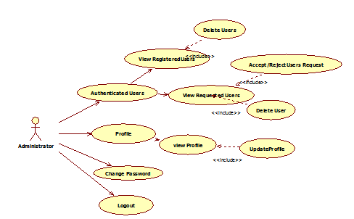
Administrator Use Case Diagram

Slide 32
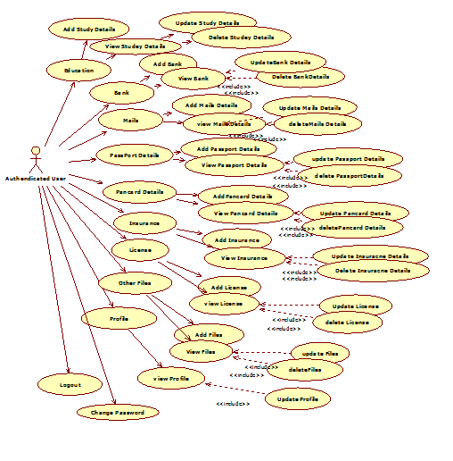
User Use Case Diagram

Slide 33
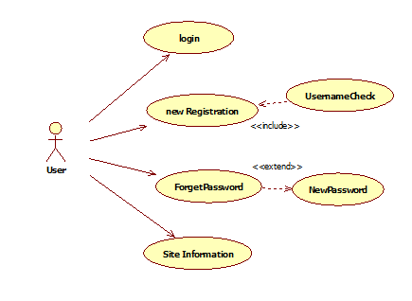
User Use Case Diagram

Slide 34
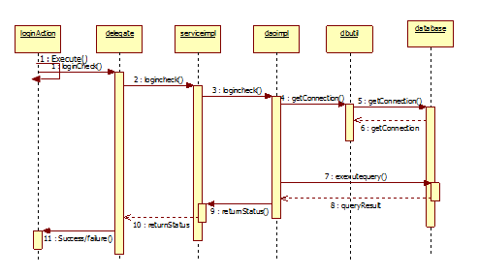
Login Sequence Diagram :

Slide 35
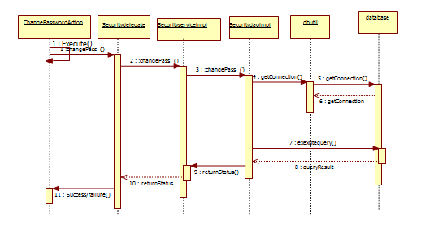
ChangePassword Sequence Diagram

Slide 36
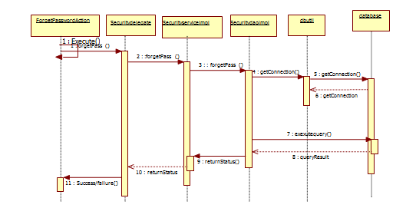
ForgetPassword:

Slide 37
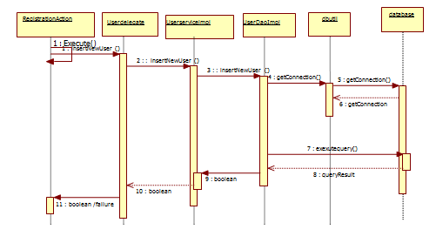
Registration Secquence Diagram

Slide 38
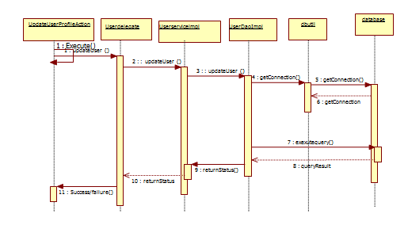
Update UserProfile Sequence Diagram

Slide 39
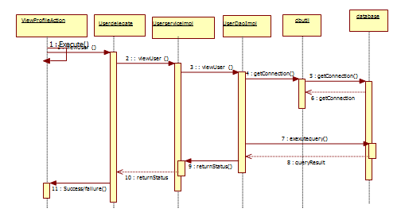
view UserProfile Sequence Diagram

Slide 40
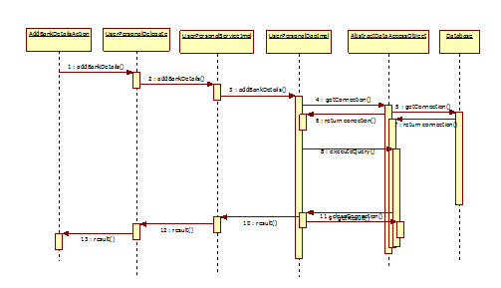
Add Bank Details Sequence Diagram

Slide 41
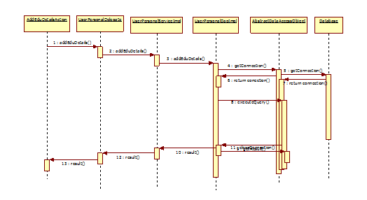
Add Career Details Sequence Diagram

Slide 42
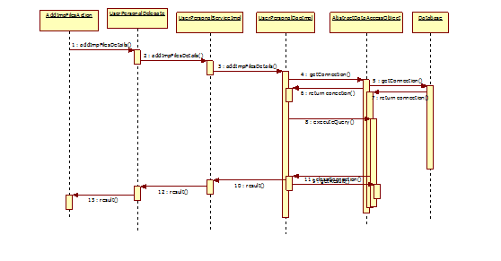
Add IMPFILEs Details Sequence Diagram

Slide 43
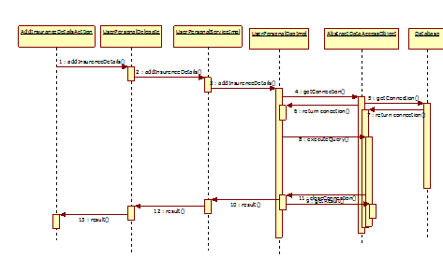
Add Insurence Details Sequence Diagram

Slide 44
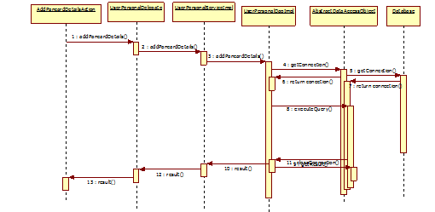
Add Add IMPFILEs Details Sequence Diagram

Slide 45
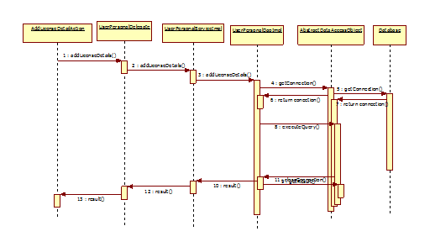
Add License Details Sequence Diagram :

Slide 46
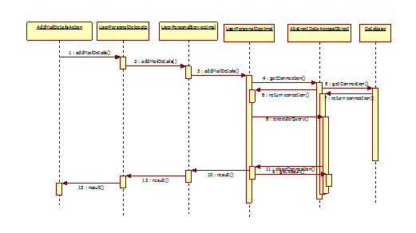
Add Mails Details Sequence Diagram

Slide 47
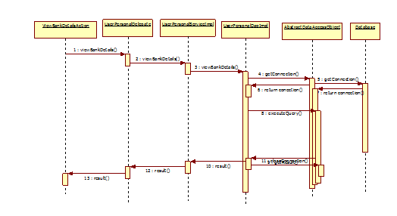
View Bank Details Sequence Diagram

Slide 48
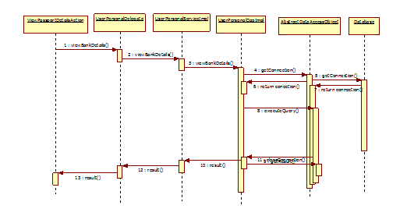
View PassPortDetails Sequence Diagram

Slide 49
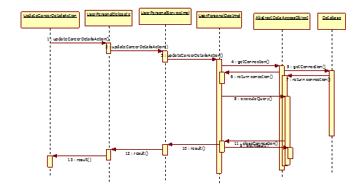
Update Career Details Sequence Diagram

Slide 50
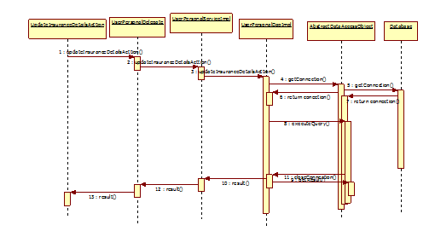
Update Insurence Details Sequence Diagram

Slide 51
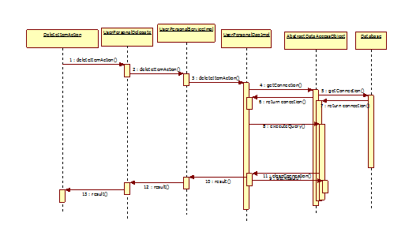
Delete Items Sequence Diagram

Slide 52
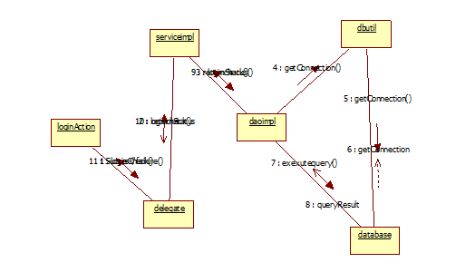
Login Sequence Collabration Diagram

Slide 53
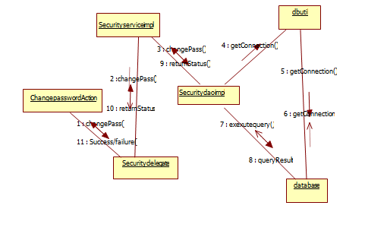
Changepassword SequenceCollbration diagram

Slide 54
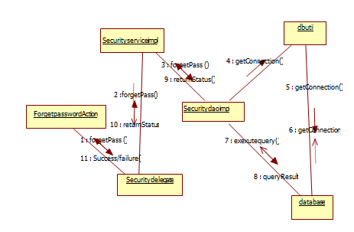
Registration Sequence CollbrationDiagram

Slide 55
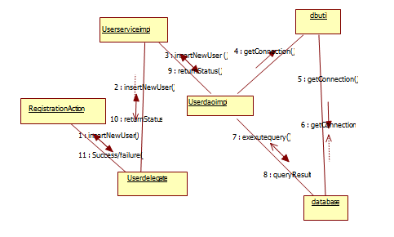
Update UserProfile SequenceCollbration Diagram

Slide 56
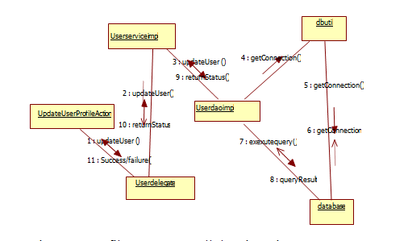
View UserProfile Sequence Collabration Diagram :

Slide 57
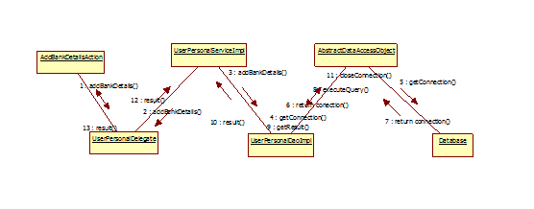
Add Bank Deaitls Sequence Collabration Diagram

Slide 58
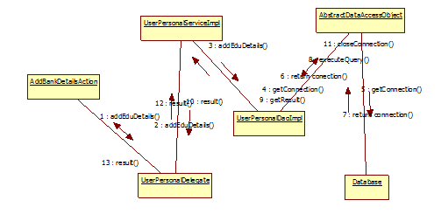
View EDU Details Sequence Collabration Diagram

Slide 59
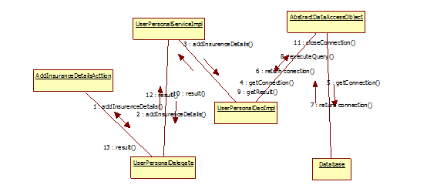
Add ImpFiles Sequence Collabration Diagram

Slide 60
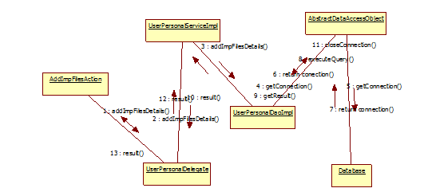
Add License Details Sequence Collabration Diagram

Slide 61
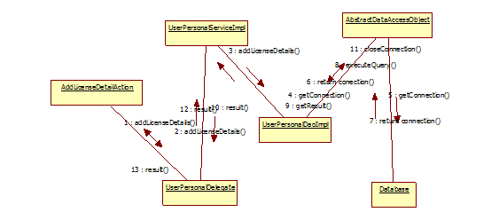
Add Mail Details Sequence Collabration Diagram

Slide 62
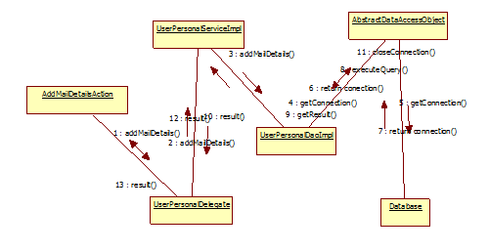
Add Pancard Details Sequence Collabration Diagram :

Slide 63
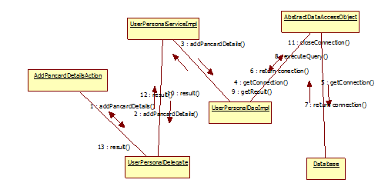
View Bank Details Sequence Collabration Diagram :

Slide 64
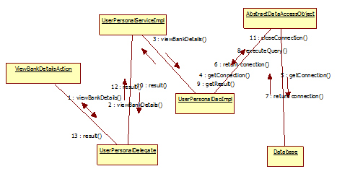
Update Career Details Sequence Collabration Diagram

Slide 65
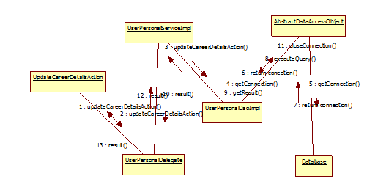
Update Career Details Sequence Collabration Diagram

Slide 66
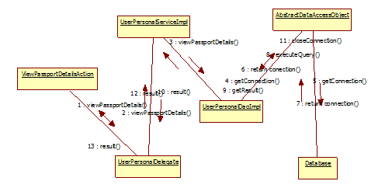
View Passport Details Sequence Collabration Diagram

Slide 67
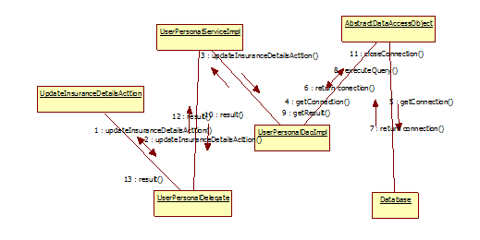
Update Insurence Details Sequence Collabration Diagram

Slide 68
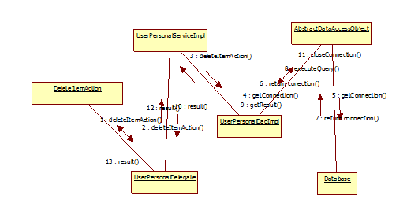
Delete item Details Sequence Collabration Diagram

Slide 69
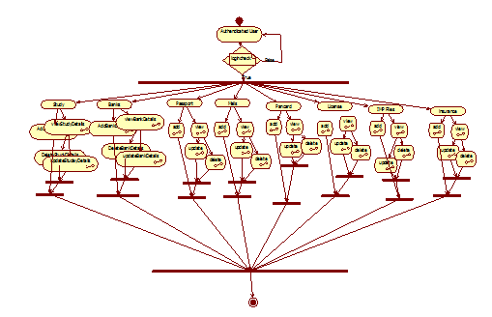
ACTIVITY DIAGRAMS Activity Diagram for Admin :

Slide 70
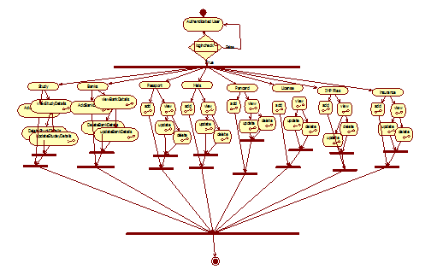
User Activity:

Slide 71
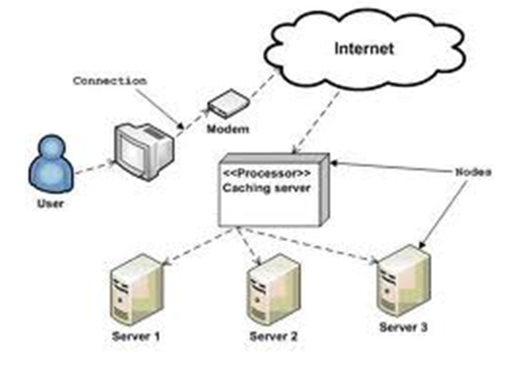
Component Diagram:

Slide 72
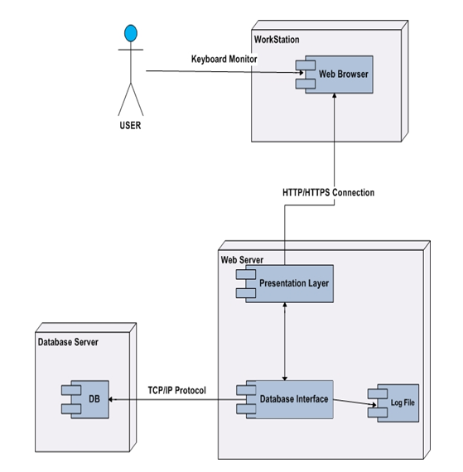
Deployment Diagram

Slide 73
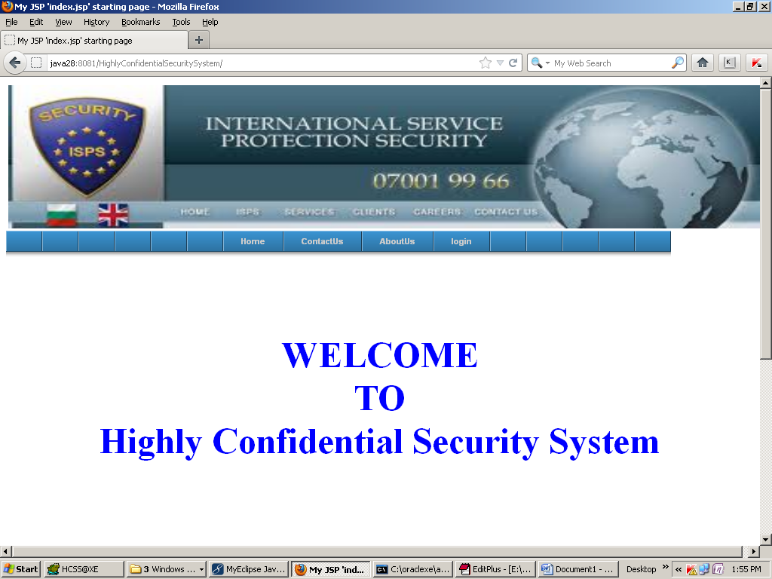
Screen shorts:

Slide 74
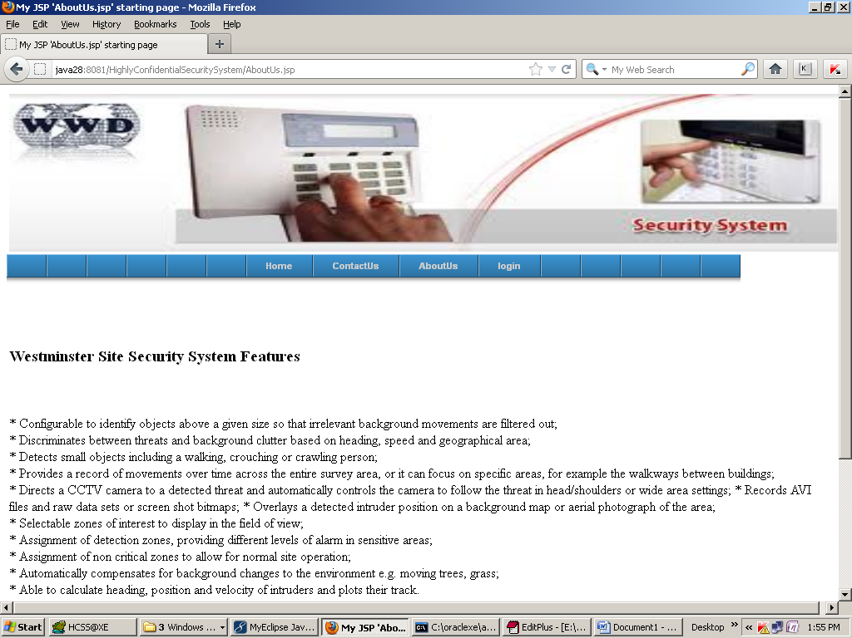

Slide 75
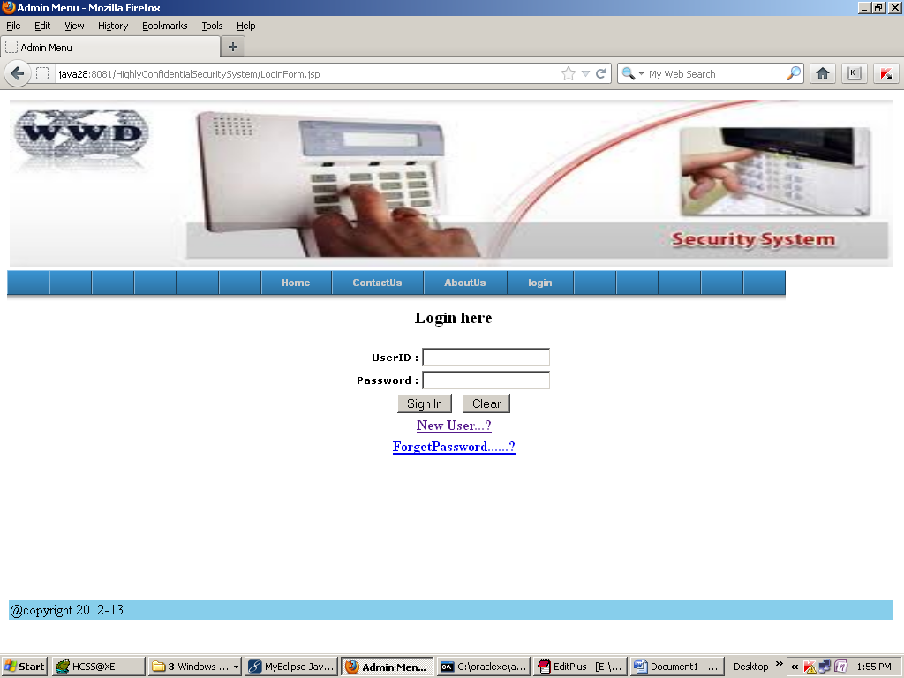

Slide 76
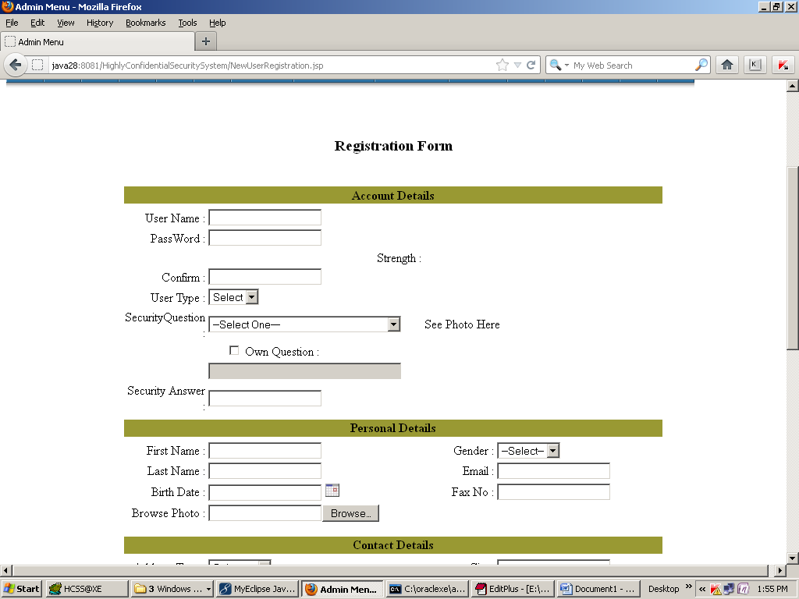

Slide 77
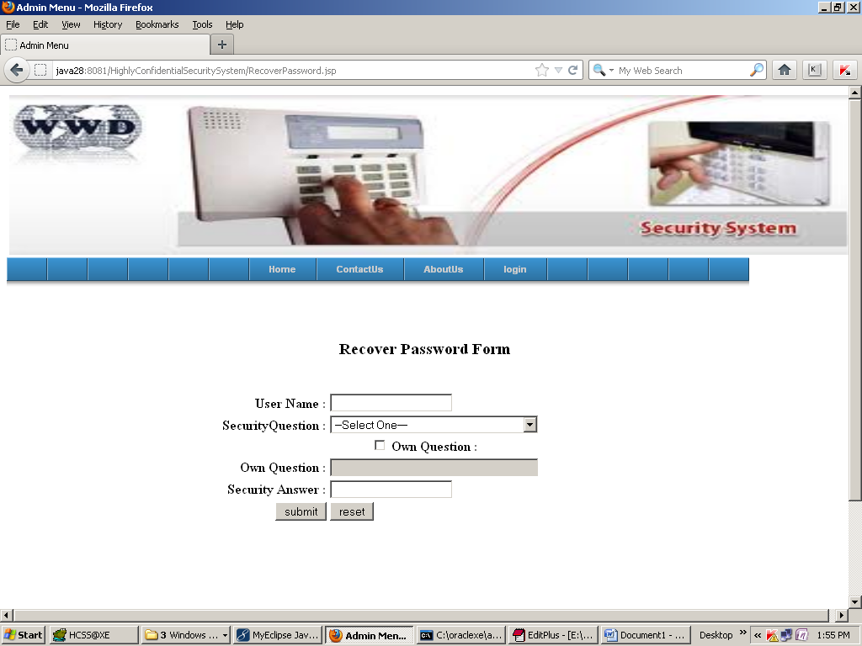

Slide 78


Slide 79


Slide 80


Slide 81


Slide 82


Slide 83
CONCLUSION:
WORK DONE:
The HCSS was successfully designed and is tested for accuracy and quality.
During this project we have accomplished all the objectives and this project meets the needs of the organization. The developed will be used in searching, retrieving and generating information for the concerned requests.
GOALS
Reduced entry work
Easy retrieval of information
Reduced errors due to human intervention
User friendly screens to enter the data
Portable and flexible for further enhancement
Web enabled.
Fast finding of information requested

Slide 84
BIBILIOGRAPHY :
(1) Java Complete Reference by Herbert Shield
(2) Database Programming with JDBC and Java by George Reese
(3) Java and XML By Brett McLaughlin
(4) Wikipedia, URL: http://www.wikipedia.org.
(5) Answers.com, Online Dictionary, Encyclopedia and much more, URL: http://www.answers.com
(6) Google, URL: http://www.google.co.in
(7) The Complete Refernce Struts James Holmes
Struts: The Complete Reference, 2nd Edition - Free PDF Ebooks Download
comcol.nl: Struts: The Complete Reference, Second Edition ...
STRUTS:The complete Reference
(8) Jakarta Struts Pocket Reference Chuck Cavaness, Brian Keeton

